Slide 1
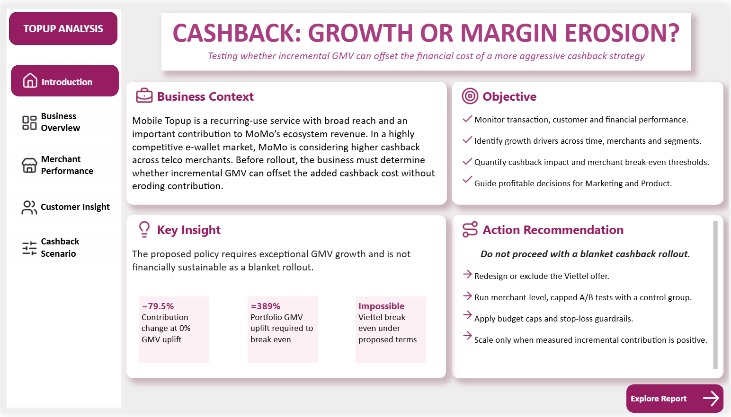
MOMO MOBILE TOPUP CASE STUDY
Cashback: Growth
or Margin Erosion?
Performance analysis and a financially sustainable cashback strategy
The decision is not whether cashback can grow GMV.
It is whether that growth can recover contribution.
SQL Server • Power BI • Jan–Dec 2020
Portfolio Project
Notes:
[Sources]
- User-authored MoMo Mobile Topup analytics project, January–December 2020.
- Project SQL Server analysis and Power BI dashboard screenshots embedded in this deck.
- Confirmed project metrics and diagnostic calculations documented in the project README.
- Slide 1: all claims and visuals are derived from the same user-authored project.

Slide 2
EXECUTIVE SUMMARY
02
Growth is fragile—and blanket cashback destroys margin
696.60M
18.75M
11.79M
13.39K
Total GMV (VND)
Gross revenue (VND)
Current contribution (VND)
Active users
Proposed cashback at 0% GMV uplift
2.41M
−79.5%
~389%
proposed contribution
vs. current contribution
overall GMV lift required
Decision
Reject blanket cashback. Test by merchant, cap spend, and scale only when incremental contribution is positive.
MoMo Mobile Topup Analysis • SQL Server + Power BI
Notes:
[Sources]
- User-authored MoMo Mobile Topup analytics project, January–December 2020.
- Project SQL Server analysis and Power BI dashboard screenshots embedded in this deck.
- Confirmed project metrics and diagnostic calculations documented in the project README.
- Slide 2: all claims and visuals are derived from the same user-authored project.

Slide 3
BUSINESS CONTEXT
03
Competitive pressure creates a growth–profitability trade-off
Overall objective
Why this matters
Build an end-to-end SQL Server and Power BI solution that explains performance, identifies growth drivers and tests cashback sustainability.
Mobile Topup is a high-reach, recurring service that supports engagement and platform revenue. Competitors use aggressive cashback to acquire and retain users, putting pressure on MoMo to respond.
•
Monitor monthly transaction, customer and financial performance.
Core tension
•
Identify time, merchant and customer drivers of GMV and revenue.
Can higher cashback create enough incremental volume to replace the contribution it sacrifices?
•
Quantify cashback economics and recommend controlled actions.
MoMo Mobile Topup Analysis • SQL Server + Power BI
Notes:
[Sources]
- User-authored MoMo Mobile Topup analytics project, January–December 2020.
- Project SQL Server analysis and Power BI dashboard screenshots embedded in this deck.
- Confirmed project metrics and diagnostic calculations documented in the project README.
- Slide 3: all claims and visuals are derived from the same user-authored project.

Slide 4
DIAGNOSTIC FRAMEWORK
04
Five lenses turn results into decisions
01
02
03
04
05
Performance
Drivers
Value
Evidence
Decision
Track GMV, orders, users and contribution.
Decompose GMV, revenue and contribution.
Compare merchant margin and customer value.
Separate proven drivers from hypotheses.
Choose actions using incremental contribution.
Decision rule: explain the driver, state the evidence limit, then act on contribution—not GMV alone.
MoMo Mobile Topup Analysis • SQL Server + Power BI
Notes:
[Sources]
- User-authored MoMo Mobile Topup analytics project, January–December 2020.
- Project SQL Server analysis and Power BI dashboard screenshots embedded in this deck.
- Confirmed project metrics and diagnostic calculations documented in the project README.
- Slide 4: all claims and visuals are derived from the same user-authored project.

Slide 5
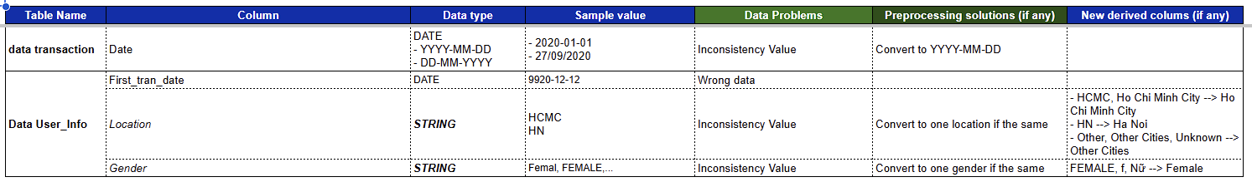
DATA PROCESSING
05
A three-layer SQL pipeline makes the analysis reproducible
RAW
STAGING
DATA WAREHOUSE
POWER BI
Preserve source
→
Clean and standardize
→
Model for analytics
→
Measure and decide
Source transaction + user files
No transformations
Dates • locations • gender
Validation + derived fields
Conformed dimensions
Transaction-grain fact
DAX measures
Interactive scenarios
Examples of source issues resolved in staging
Mixed date formats
Invalid first transaction date
HCMC / HN location aliases
Gender capitalization
MoMo Mobile Topup Analysis • SQL Server + Power BI
Notes:
[Sources]
- User-authored MoMo Mobile Topup analytics project, January–December 2020.
- Project SQL Server analysis and Power BI dashboard screenshots embedded in this deck.
- Confirmed project metrics and diagnostic calculations documented in the project README.
- Slide 5: all claims and visuals are derived from the same user-authored project.

Slide 6
DATA MODEL
06
The warehouse separates entities from transactions
dw.dim_date
Day • week • month
quarter • year • weekend
dw.dim_user
fact_transaction
dw.dim_merchant
Gender • age • location
first transaction date
One row per Topup event
Merchant • commission rate
proposed cashback rate
GMV • revenue • cashback
DAX measure layer
GMV • ARPU • contribution
scenario • break-even
dim_date is generated in SQL to guarantee a complete calendar and consistent Month, Quarter and Weekday analysis.
MoMo Mobile Topup Analysis • SQL Server + Power BI
Notes:
[Sources]
- User-authored MoMo Mobile Topup analytics project, January–December 2020.
- Project SQL Server analysis and Power BI dashboard screenshots embedded in this deck.
- Confirmed project metrics and diagnostic calculations documented in the project README.
- Slide 6: all claims and visuals are derived from the same user-authored project.

Slide 7
DIAGNOSTIC FINDINGS
07
Three diagnostics explain the growth story
Monthly GMV (VND millions)
65.4M
High AOV explains
part of Sep's peak
2.9×
2.9× AOV drives
outsized GMV share
1.01×
Orders ≈ users:
repeat volume is low
Diagnosis
GMV is growing, but repeat usage is the clearest confirmed constraint; campaign causes remain unproven.
MoMo Mobile Topup Analysis • SQL Server + Power BI
Notes:
[Sources]
- User-authored MoMo Mobile Topup analytics project, January–December 2020.
- Project SQL Server analysis and Power BI dashboard screenshots embedded in this deck.
- Confirmed project metrics and diagnostic calculations documented in the project README.
- Slide 7: all claims and visuals are derived from the same user-authored project.

Slide 8
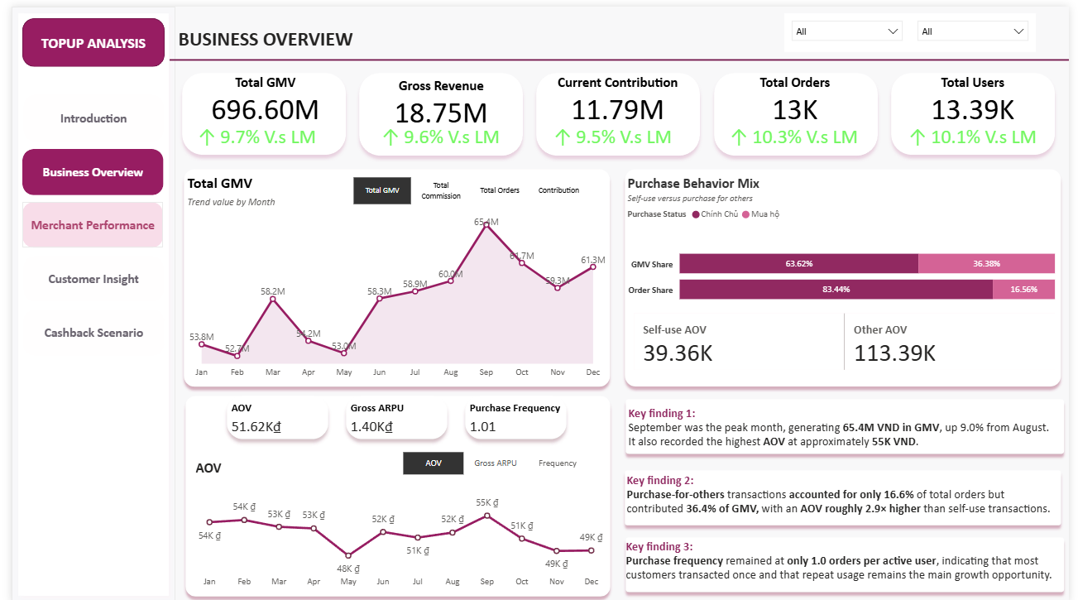
POWER BI REPORT • BUSINESS OVERVIEW
08
Higher AOV lifted September; repeat usage stayed near one
Why performance moved
01
The year's highest AOV confirms transaction value helped create September's GMV peak.
02
Purchase-for-others generated 36.4% of GMV because its AOV was 2.9× self-use.
03
13,496 orders from 13,391 users confirm limited repeat volume at portfolio level.
Priority: second Topup within 30 days.
MoMo Mobile Topup Analysis • SQL Server + Power BI
Notes:
[Sources]
- User-authored MoMo Mobile Topup analytics project, January–December 2020.
- Project SQL Server analysis and Power BI dashboard screenshots embedded in this deck.
- Confirmed project metrics and diagnostic calculations documented in the project README.
- Slide 8: all claims and visuals are derived from the same user-authored project.

Slide 9
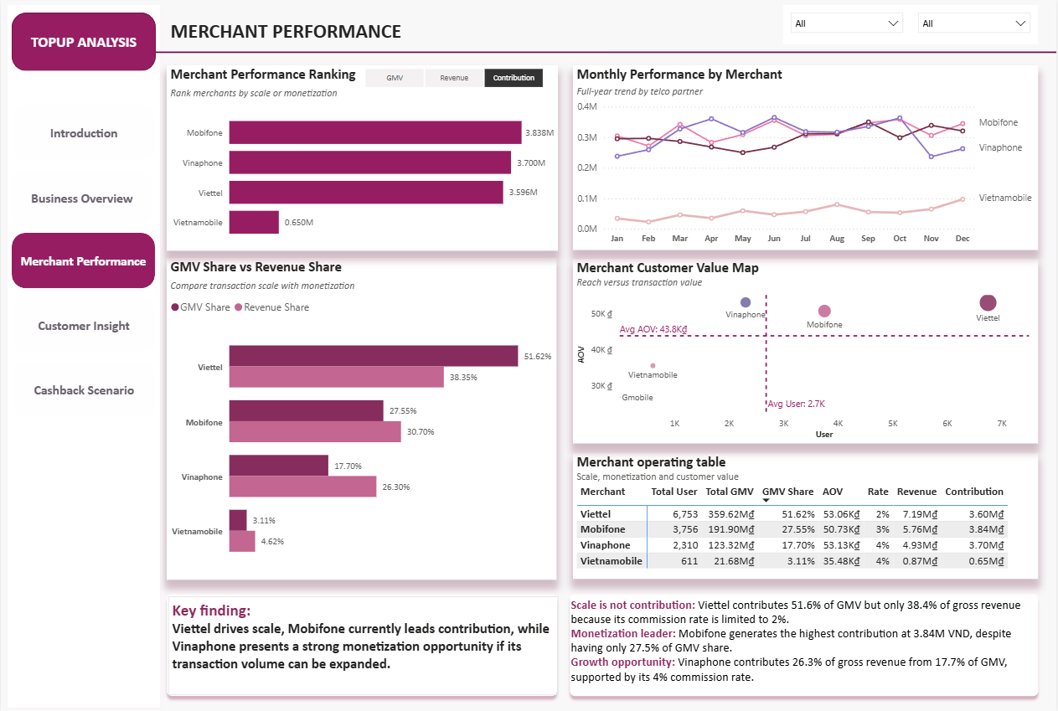
POWER BI REPORT • MERCHANT PERFORMANCE
09
Commission rates—not GMV share—explain merchant value
Contribution reflects margin
VND millions
•
Viettel: 51.6% of GMV but only 38.4% of revenue because commission is 2%.
•
Mobifone leads contribution at 3.84M VND with an effective margin near 2%.
•
Vinaphone over-indexes on revenue because its commission rate is 4%.
MoMo Mobile Topup Analysis • SQL Server + Power BI
Notes:
[Sources]
- User-authored MoMo Mobile Topup analytics project, January–December 2020.
- Project SQL Server analysis and Power BI dashboard screenshots embedded in this deck.
- Confirmed project metrics and diagnostic calculations documented in the project README.
- Slide 9: all claims and visuals are derived from the same user-authored project.

Slide 10
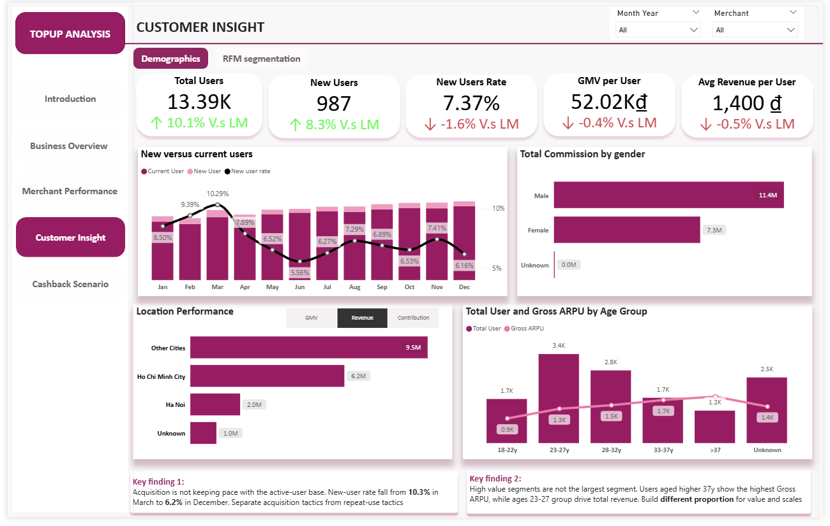
POWER BI REPORT • CUSTOMER INSIGHT
10
Acquisition faded; customer scale and value diverged by age
13.39K
total users
7.37%
new-user rate
What is confirmed
New users fell 113 → 76. Campaign and channel causes are not observable in this dataset.
Who creates value
Ages 23–27 lead through scale; users over 37 lead on Gross ARPU. They need different offers.
MoMo Mobile Topup Analysis • SQL Server + Power BI
Notes:
[Sources]
- User-authored MoMo Mobile Topup analytics project, January–December 2020.
- Project SQL Server analysis and Power BI dashboard screenshots embedded in this deck.
- Confirmed project metrics and diagnostic calculations documented in the project README.
- Slide 10: all claims and visuals are derived from the same user-authored project.

Slide 11
CASHBACK ECONOMICS
11
Margin compression removes 79.5% of contribution
CURRENT POLICY
PROPOSED POLICY
BREAK-EVEN REQUIREMENT
11.79M
→
2.41M
→
~389%
Current contribution
Contribution at 0% uplift
Overall GMV lift
Contribution gap
Cashback cost rises immediately; the GMV needed to recover lost margin is only an assumption.
−9.38M VND
Decision rule
Approve growth only when incremental revenue exceeds incremental cashback cost.
MoMo Mobile Topup Analysis • SQL Server + Power BI
Notes:
[Sources]
- User-authored MoMo Mobile Topup analytics project, January–December 2020.
- Project SQL Server analysis and Power BI dashboard screenshots embedded in this deck.
- Confirmed project metrics and diagnostic calculations documented in the project README.
- Slide 11: all claims and visuals are derived from the same user-authored project.

Slide 12
MERCHANT RISK
12
Viettel makes blanket break-even structurally impossible
Required GMV lift to preserve current contribution
VIETTEL
Break-even impossible
2% commission − 2% cashback = 0% contribution margin
Why portfolio break-even rises
•
Viettel is over half of GMV but retains zero margin.
•
Other merchants must recover their own compressed margins.
•
They must also replace Viettel's lost contribution.
Mobifone needs +300%; Vinaphone and Vietnamobile need +200%.
MoMo Mobile Topup Analysis • SQL Server + Power BI
Notes:
[Sources]
- User-authored MoMo Mobile Topup analytics project, January–December 2020.
- Project SQL Server analysis and Power BI dashboard screenshots embedded in this deck.
- Confirmed project metrics and diagnostic calculations documented in the project README.
- Slide 12: all claims and visuals are derived from the same user-authored project.

Slide 13
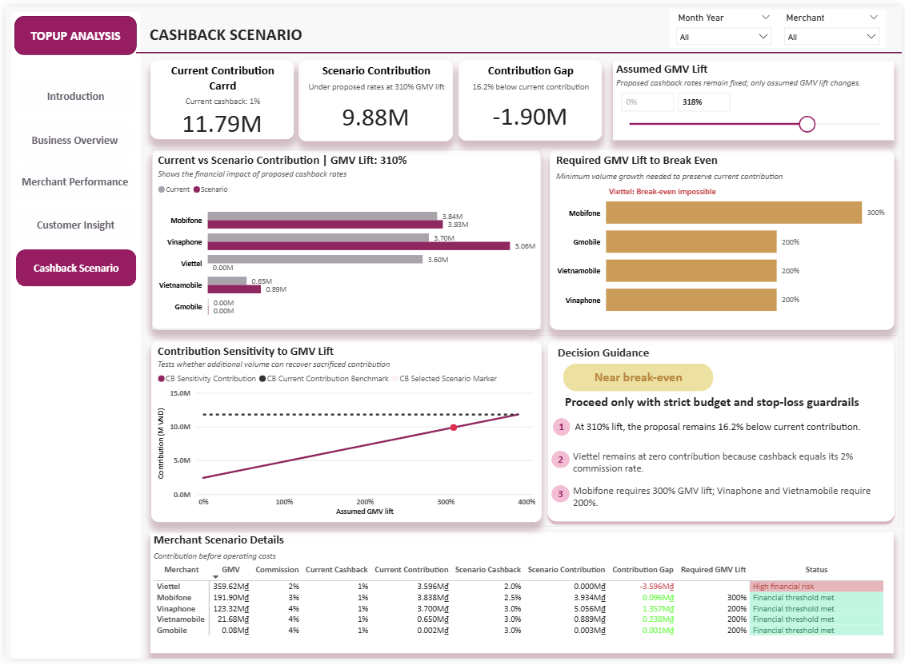
POWER BI REPORT • CASHBACK SCENARIO
13
A 310% GMV lift still misses break-even by 16.2%
310%
assumed GMV lift
9.88M
scenario contribution
−1.90M
contribution gap
Still below break-even
Test only—do not scale. Keep a strict budget cap and stop-loss.
MoMo Mobile Topup Analysis • SQL Server + Power BI
Notes:
[Sources]
- User-authored MoMo Mobile Topup analytics project, January–December 2020.
- Project SQL Server analysis and Power BI dashboard screenshots embedded in this deck.
- Confirmed project metrics and diagnostic calculations documented in the project README.
- Slide 13: all claims and visuals are derived from the same user-authored project.

Slide 14
ACTIONABLE RECOMMENDATIONS
14
Three actions convert diagnosis into controlled growth
Protect margin
PRODUCT + FINANCE
P0
Reject blanket rollout. Set cashback below merchant commission or secure co-funding; enforce budget caps and stop-loss.
Create repeat usage
CRM + GROWTH
P1
Drive a second Topup within 30 days using lifecycle reminders and purchase-for-others occasions, not broad discounts.
Allocate by value
MARKETING + PARTNERSHIPS
P2
Use Viettel for reach, Mobifone for contribution and Vinaphone for monetization-led tests; tailor offers by customer value.
MoMo Mobile Topup Analysis • SQL Server + Power BI
Notes:
[Sources]
- User-authored MoMo Mobile Topup analytics project, January–December 2020.
- Project SQL Server analysis and Power BI dashboard screenshots embedded in this deck.
- Confirmed project metrics and diagnostic calculations documented in the project README.
- Slide 14: all claims and visuals are derived from the same user-authored project.

Slide 15
DECISION FRAMEWORK
15
Scale only when contribution—not GMV—wins
Run merchant-specific, capped A/B tests
Control • fixed window • budget cap • stop-loss • retention check
SCALE
ITERATE
STOP
Incremental contribution > 0
Repeat usage improves
Economics hold by merchant
GMV grows; contribution is weak
Adjust rate, segment or cap
Retest one variable
Loss exceeds stop-loss
No repeat improvement
Viettel margin stays zero
Primary KPI
Incremental Contribution = Incremental Revenue − Incremental Cashback Cost
MoMo Mobile Topup Analysis • SQL Server + Power BI
Notes:
[Sources]
- User-authored MoMo Mobile Topup analytics project, January–December 2020.
- Project SQL Server analysis and Power BI dashboard screenshots embedded in this deck.
- Confirmed project metrics and diagnostic calculations documented in the project README.
- Slide 15: all claims and visuals are derived from the same user-authored project.

